Slide 1

Spotify Trend Analysis Using Tableau

Slide 2
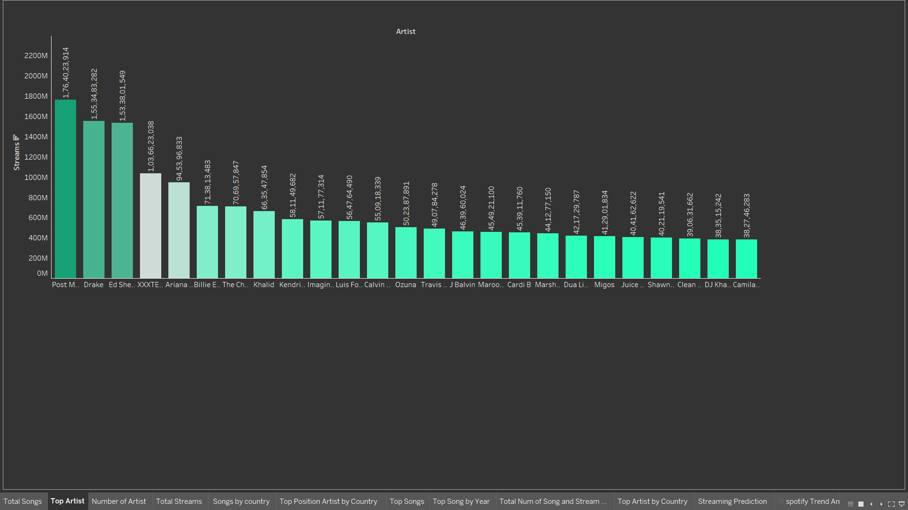
Top Artist
There are 7911 artists songs are available in spotify.
I picked top 25 artists.
Post Malone's tracks are the highest streams on spotify followed by drake’s tracks are the second highest streams.

Slide 3
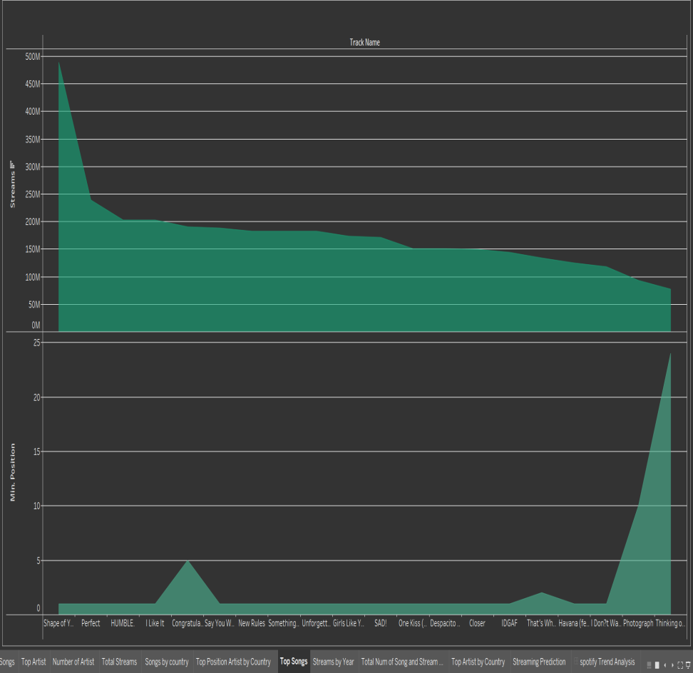
Top Songs
There are 33538 songs are available in spotify.
I picked top 20 songs and mention it’s rank.
Shape of You is the most streamed song on spotify with over 1.7 billion streams.

Slide 4
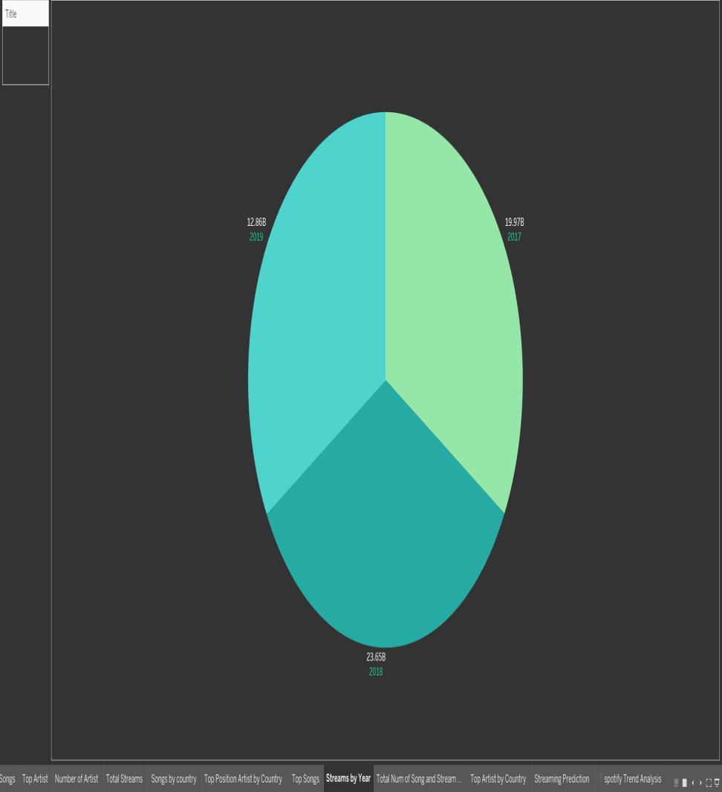
Streams by Year
2017 total streams is 19.97 billion and next year it increased 23.65 billion, 3.68 billion streams increase.
2019 total streams is 12.86 billion, 10.79 billion streams decrease.

Slide 5
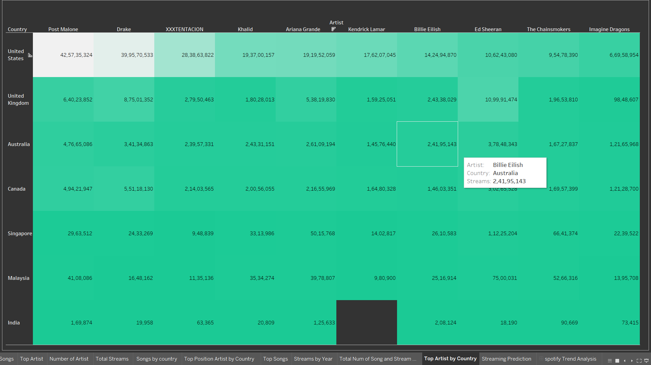
Top Artist by Country
This table is explains top artist by each country.
I picked top 10 artist’s songs are streamed each country.
Post Malone's track are most streamed in USA.

Slide 6
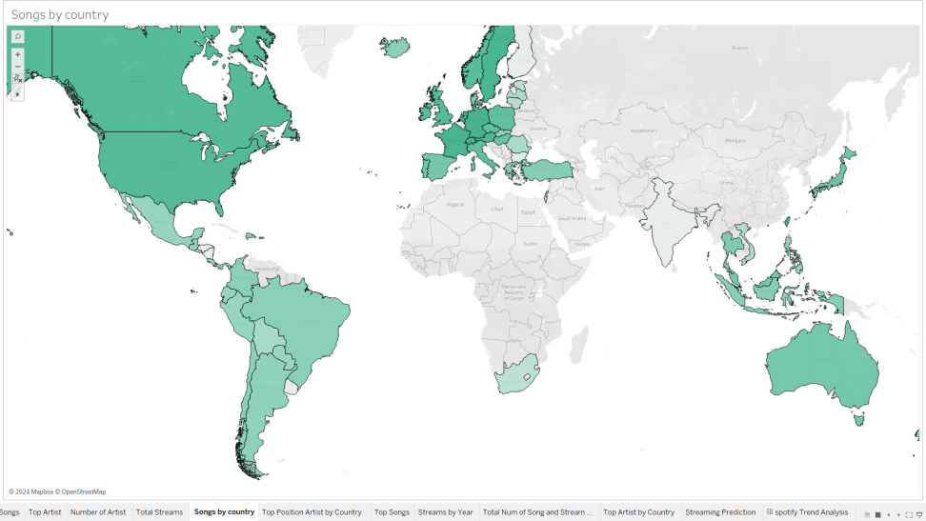
Number of Songs by Country
In Netherland, 2017 to 2019 totally 3169 songs were released.
In Nicaragua, lowest number of songs (149) were released.

Slide 7
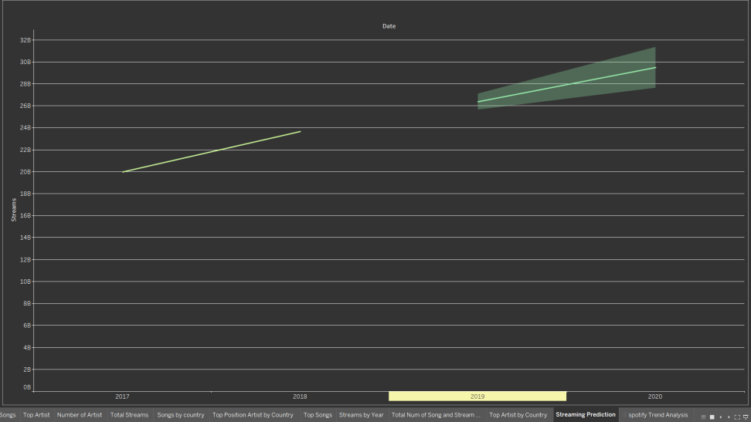
Streaming Prediction
Between 2017 and 2018 total streams is 43.62 billion.
In the way of prediction 2020 there is a chance to reach 29.48 billion.

Slide 8
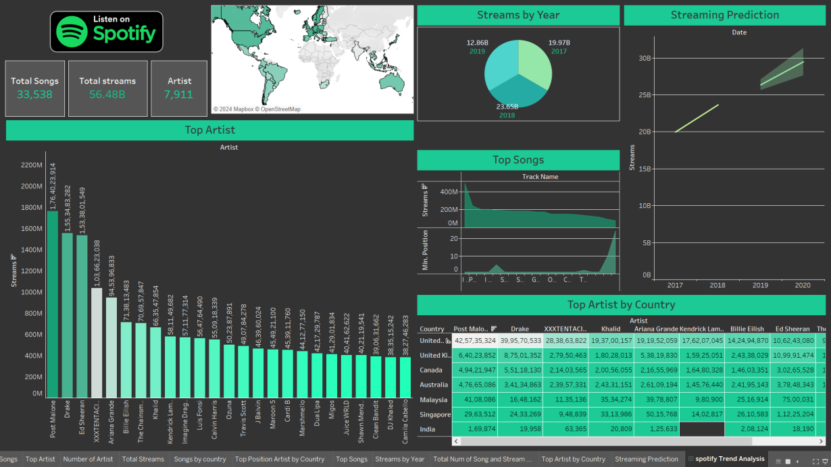
Spotify Trend Analysis Dashboard
This is my dashboard using multiple number card, pie chat, bar chat, line chat, area chat, tables and map.
Bar chat for analysis a top artists.
Pie chat for yearly total streams.
Area char for analysis the trending songs.
Line char for predicting streams for next year.

Slide 9
Conclusion
Ed Sheeran and Post Malone are the top artist all over the world.
In India has less number of streams and less number of songs were releases.
We focus ads in Indian market and we sponsor some leading independent music artist.
Then buying leading music directors album, and leading actors movie songs.
This way to easily capture Indian market.

Slide 10
Tableau Dashboard Link
https://public.tableau.com/views/spotife/spotifyTrendAnalysis?:language=en-GB&publish=yes&:sid=&:display_count=n&:origin=viz_share_link

